Slide 1

FINAL REPORT
SUBJECT:
DATA MINING
Students:
Ho Trong Khang (Leader)
ID: 19521661
Tran Nhat Tan
ID: 19522177
Le Tuan Khanh
ID: 19521681
Le Tien Vinh
ID: 19522521
Instructor : Mrs. Cao Thi Nhan
Mr. Vu Minh Sang

Slide 2


TOPIC:
PREDICT EMPLOYMENT TERMINATION

Slide 3
REASON OF PROJECT

Slide 4


REASON OF PROJECT
In an organization, workers play an essential role and are the core of bringing the innovation process into depth and promoting the industry.
When someone terminates the contract at a specific position, it is necessary to have another person replace that position.

Slide 5

REASON OF PROJECT
Create machines to make predictions about the employees who may terminate the contract, helping the heads to have more insight into issues in the company such as working environment, the position of each employee, about the departure of employees, thereby making decisions, future orientation as well as having earlier preparation of their human resources.
Especially, important positions in the organization, finding the right person in a short time is essential and difficult.

Slide 6
AIMS OF THE STUDY
It is possible to process and clean the collected data into a valuable data source for the problem.
Explore, analyze, and visualize datasets.
Building a natural language data system, using machine learning to train machines to make highly reliable information and predictions for humans.
Compare efficiency and accuracy between models.
Predict employee termination, help limit damages, and optimize work for the organization.

Slide 7
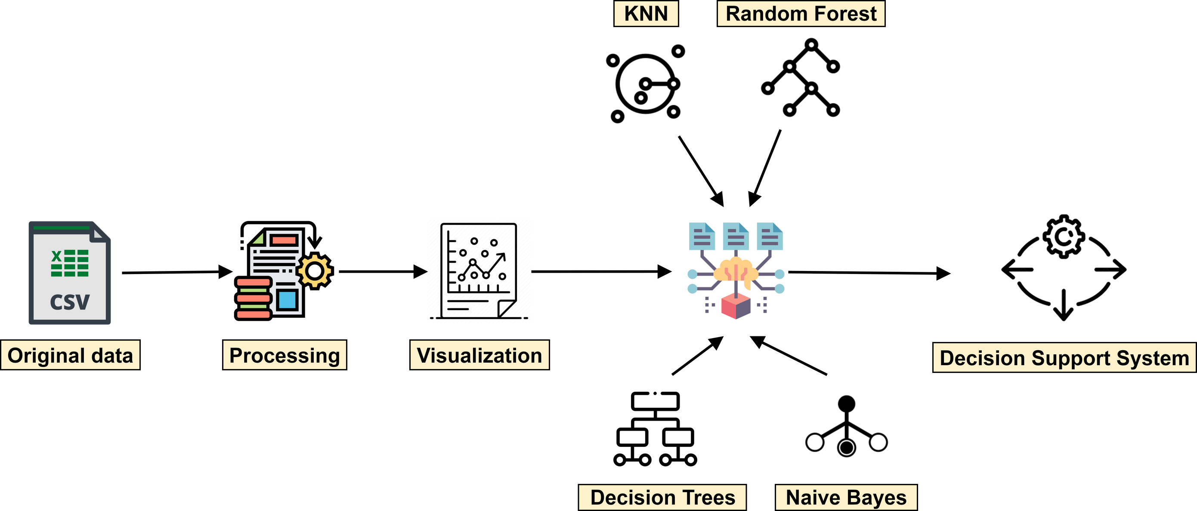

PROCESS OVERVIEW
Logistic Regresion
Prediction application

Slide 8

CONTENTS

Slide 9



CONTENTS
01
02
TOPIC OVERVIEW
Deployment
03
04
Conclusion
BUILD AN APPLICATION AND DEMO

Slide 10
01
TOPIC OVERVIEW
1. Topic content
2. Description of original data

Slide 11
1. Topic content
Data sources: Predict employment termination | Kaggle
Link: hthttps://www.kaggle.com/code/dredlaw/predict-employment-termination/data
Author : DREDLAW
The data warehouse collects information about employees (age, workplace, working time, location, ..) over the years 2006 to 2015
Through which users can know the following information:

Slide 12
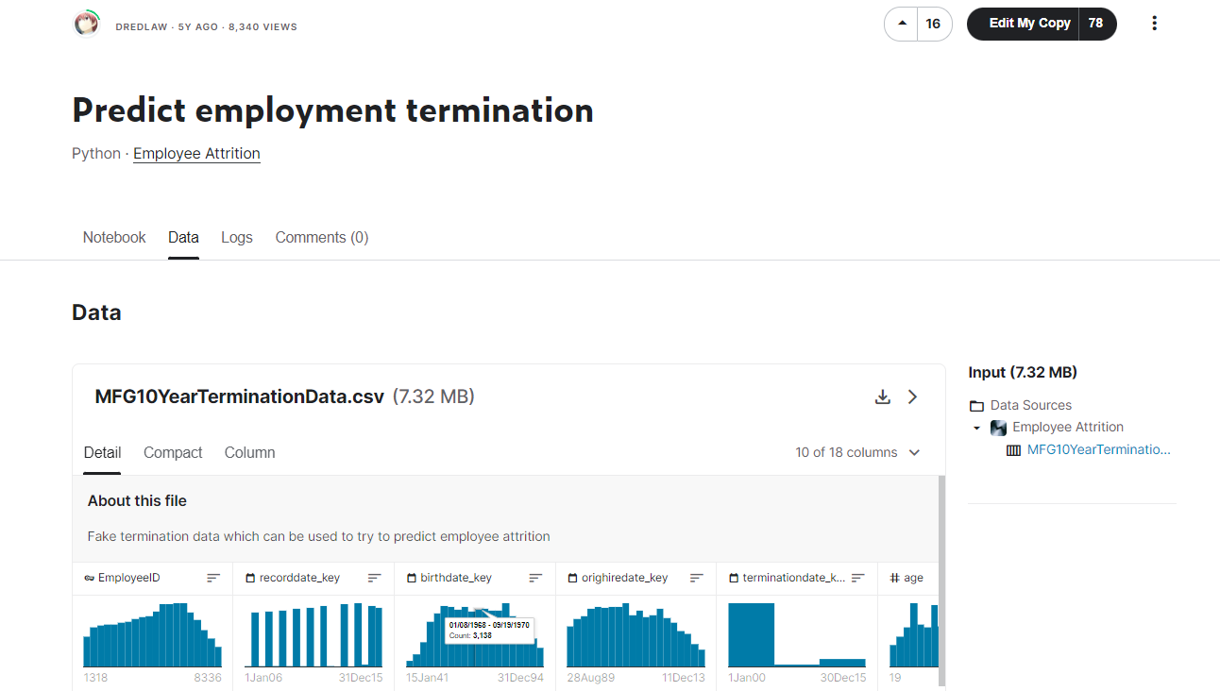
Data sources: Predict employment termination | Kaggle
Link: hthttps://www.kaggle.com/code/dredlaw/predict-employment-termination/data
1. Topic content
Author : DREDLAW
The data warehouse collects information about employees (age, workplace, working time, location, ..) over the years 2006 to 2015
Through which users can know the following information:
49653
18
Rows
Columns
6284
Employees

Slide 13
2. Description of original data
STT | Attribute | Attribute meaning | Attribute type | Value of property | Average value | Median value | Mode
1 | EmployeeID | Customer's identify |  | From 1319-8336 | 4860 | 5031
2 | Recorddate_key | Record date
3 | Birthday_key | Customer's date of birth
4 | Orighiredate_key | Official hire date
5 | Terminationdate_key | The day of the dismissal.
6 | Age | Age | Ordinal | 19 - 65 years old | 42.1 | 42 | 27
7 | Length_of_service | Service time |  | 0 - 26 years | 10.4 | 10 | 14
8 | City_name | City name of working staff |  | 40 companies |  |  | Vancouver
9 | Department_name | Department name |  | 21 departments |  |  | Meats

Slide 14
2. Description of original data
STT | Attribute | Attribute meaning | Attribute type | Value of property | Average value | Median value | Mode
10 | Job_title | Title |  | 47 titles |  |  | Meat Cutter
11 | Store_name | Store name |  | From 1 to 46 | 27.3 | 28 | 42
12 | Gender_short | Abbreviated gender |  | F - M |  |  | F
13 | Gender_full | Gender |  | Female-Male |  |  | Female
14 | Termreason_desc | Term reasons | Nominal | Layoff, Not Applicable, Retirement, Resignaton |  |  | Not Applicable
15 | Termtype_desc | Term format | Nominal | Involuntary, Not applicable, voluntary |  |  | Not applicable
16 | Status_Year |  |  | 2006 - 2015 | 2011 | 2011 | 2013
17 | Status | Status | Nominal | Active, Terminated |  |  | Active
18 | Business_Unit | Business Unit | Nominal | Stores, Headoffice |  |  | Stores

Slide 15
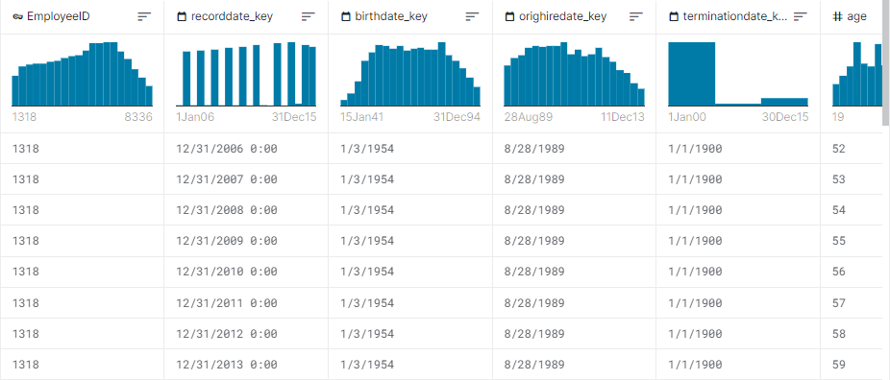
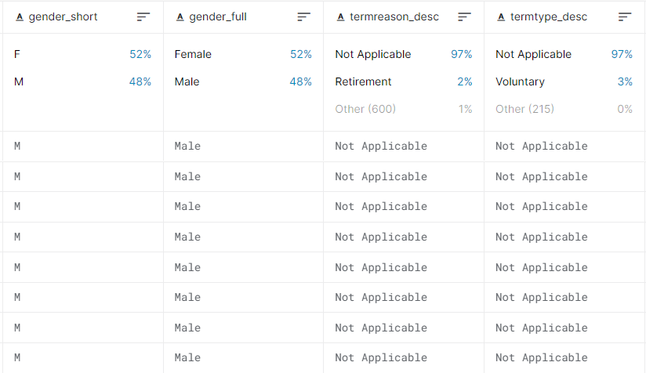
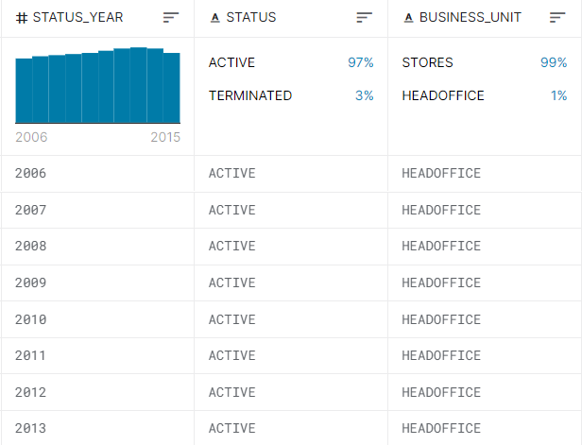
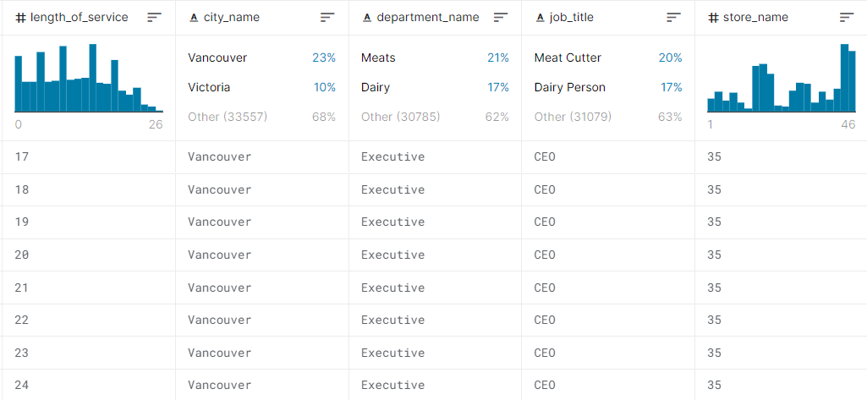
2. Description of original data

Slide 16
CONTENTS
01
02
TOPIC OVERVIEW
Deployment
03
04
Conclusion
BUILD AN APPLICATION AND DEMO

Slide 17
02
Deployment
Data preprocessing
Data visualization
Algorithm & experiment

Slide 18
01
DATA PREPROCESSING

Slide 19
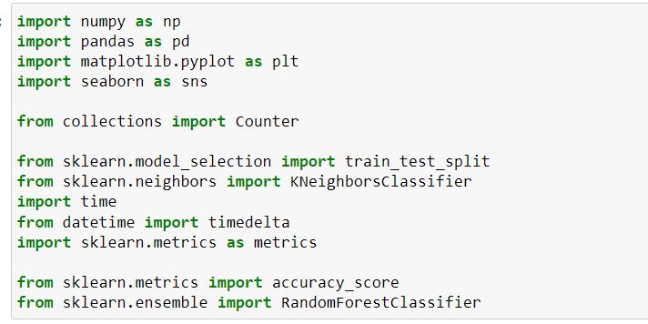
Import package & libraries

Slide 20
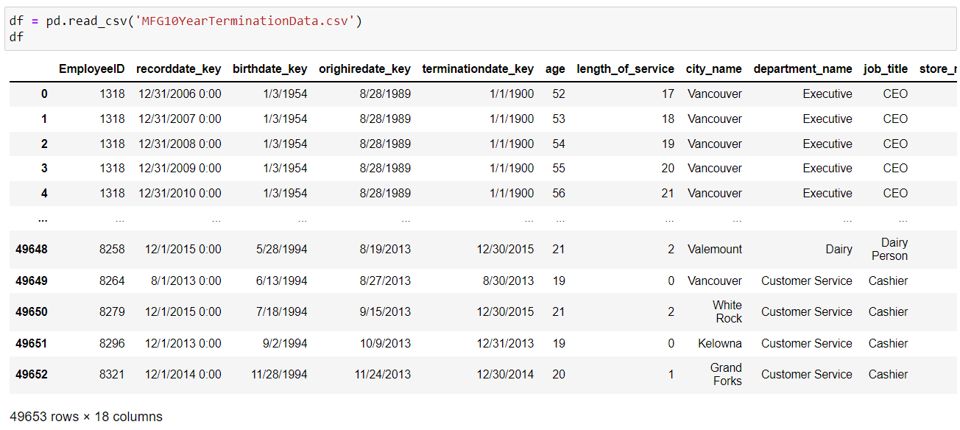
Import data file

Slide 21
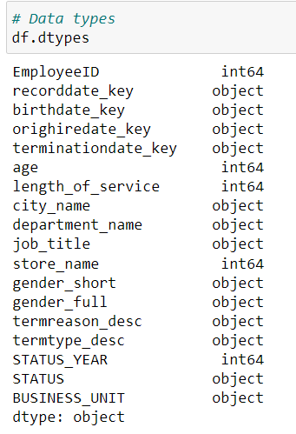
Check data type

Slide 22
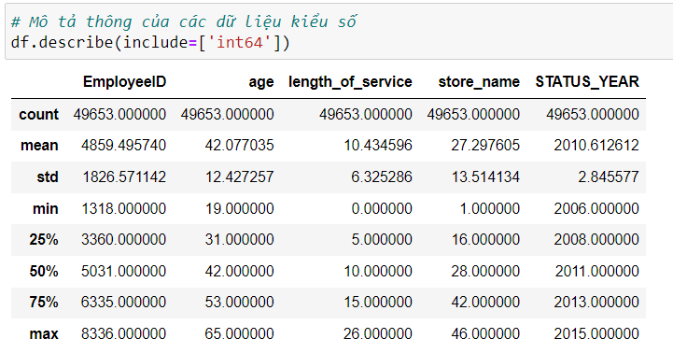
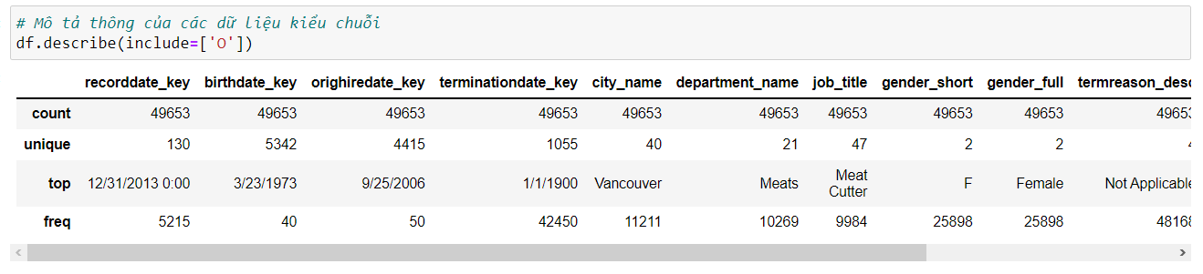
Description of information
non-numerical data
numerical data

Slide 23
Change column BUSINESS_UNIT value

Slide 24
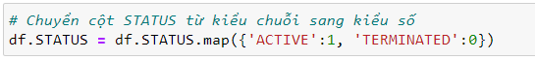
Change column STATUS value

Slide 25
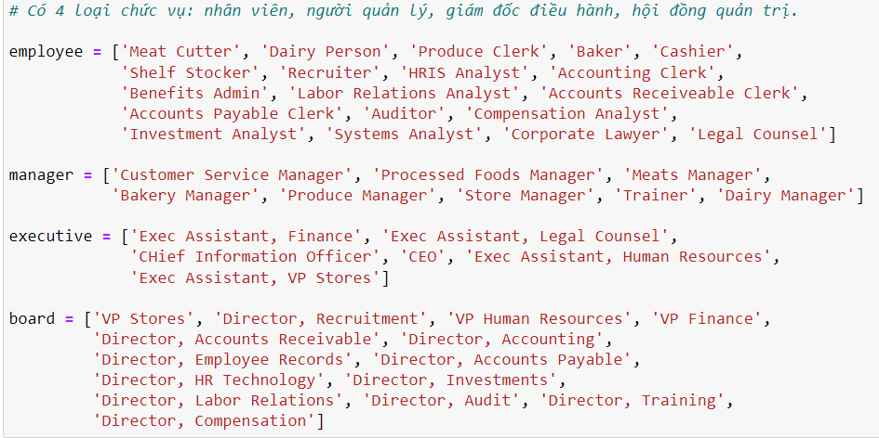
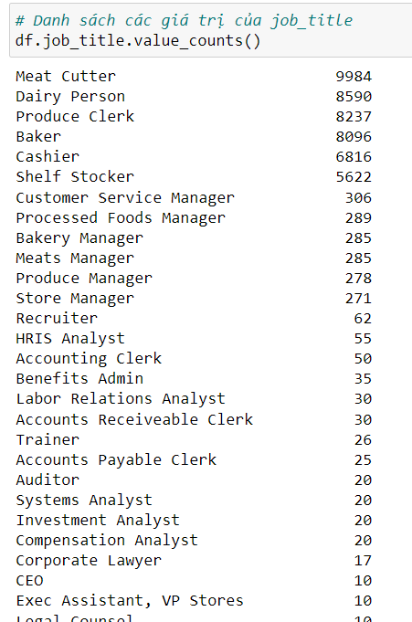
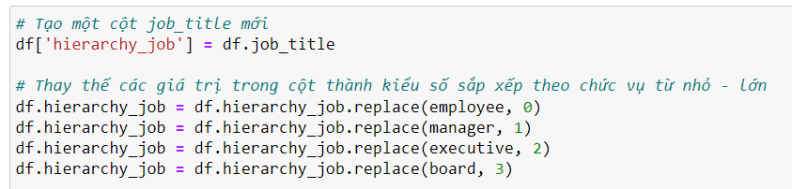
Create new categories for job_titles
47 jobs
Make a copy of job titles in a new column
Replace the job titles in Hierarchy by numeric
and order from small to large
Separated according to corporate hierarchy

Slide 26
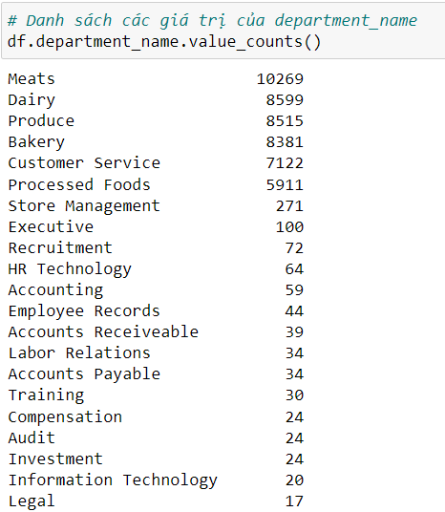
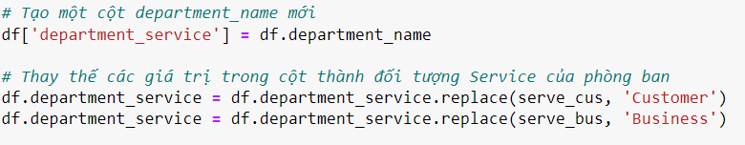
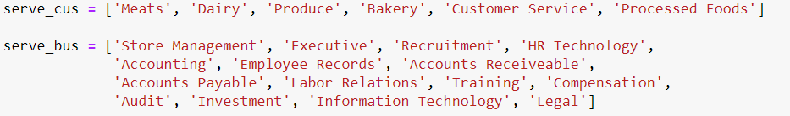
Create new categories for department_name
21 departments
Make a copy of job titles in a new column
Separated according to whether they serve the customer
Replace the department name with a service object

Slide 27
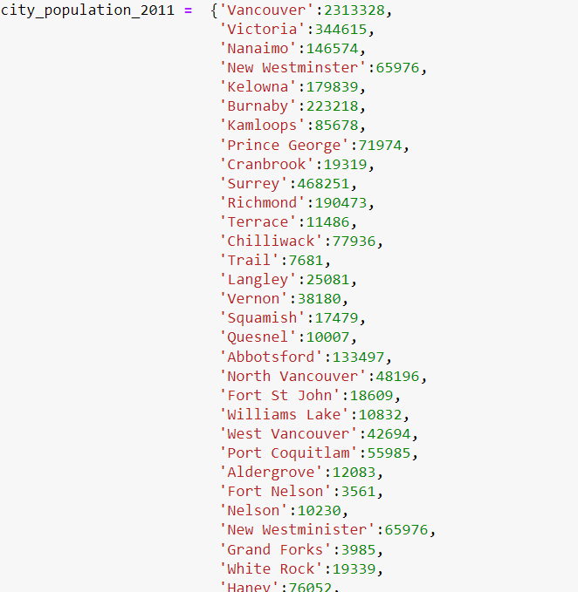
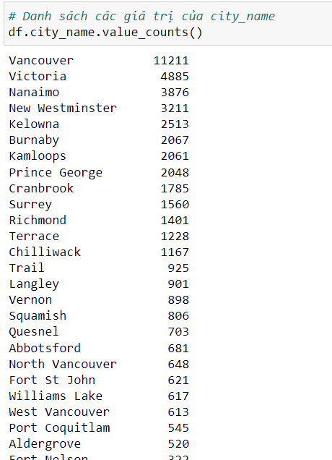
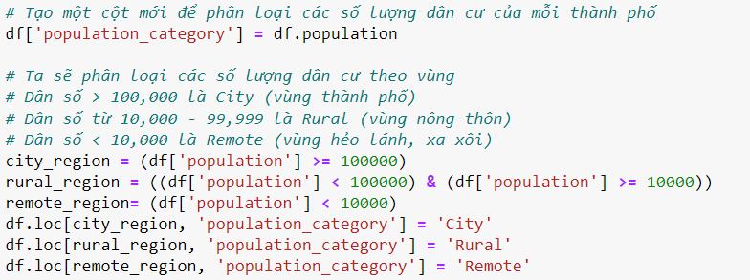
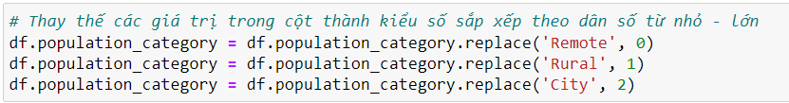
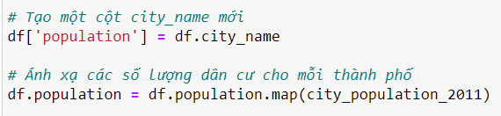
Create new categories for city_name
Separated according to population size
40 cities
Replace the population category by numeric
and order from small to large
Make a copy of city name in a new column
Map from city name to population
Make a new column for population category
Categorise according to population size

Slide 28
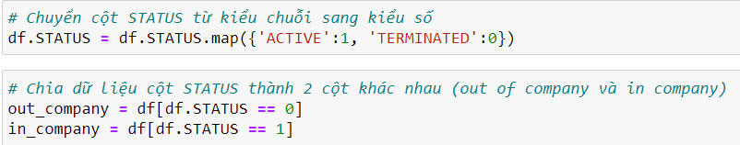
Data processing for column STATUS

Slide 29
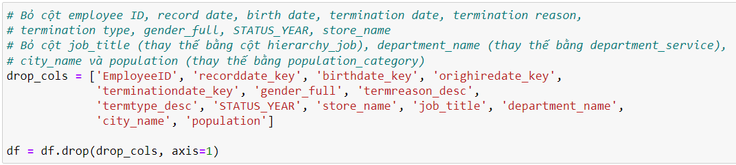
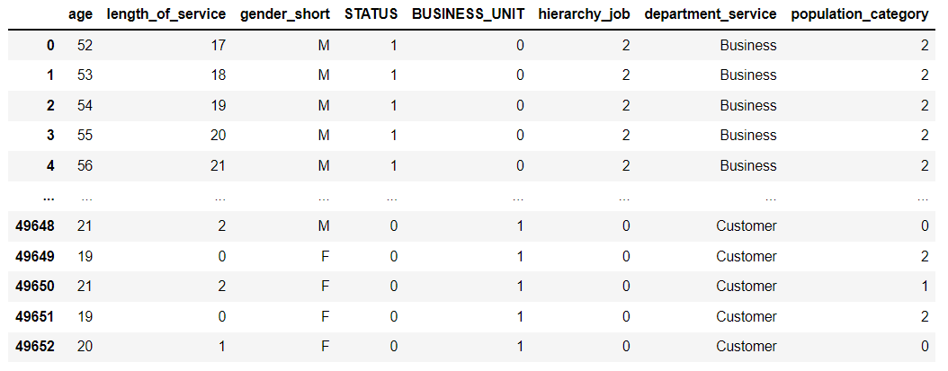
Delete processed columns

Slide 30
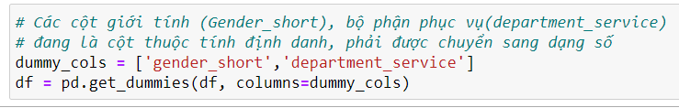
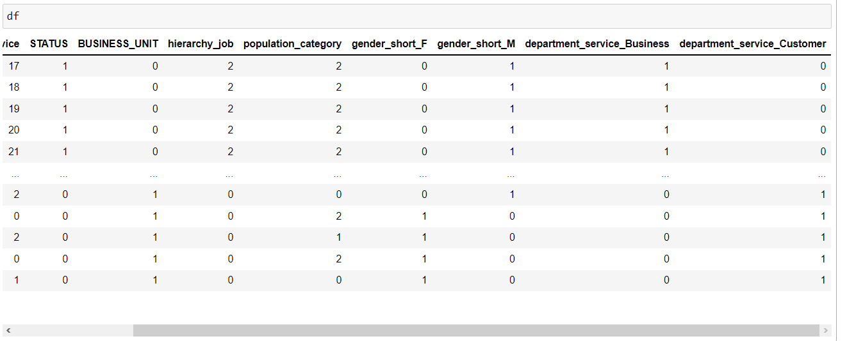
Dummy columns

Slide 31
02
DATA VISUALIZATION

Slide 32
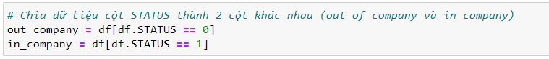
Separate the data of column STATUS
Separate data to avoid one excessively overlapping
the other in plots
One set for the
terminated (out of company) and working (in company)

Slide 33
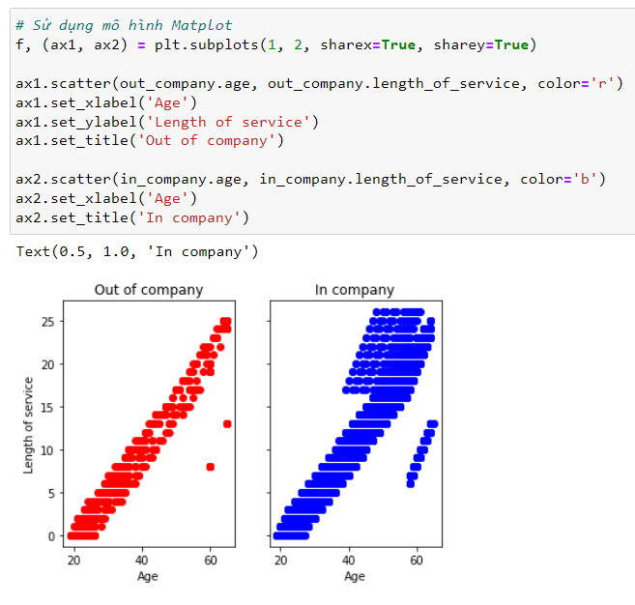
Look at each group in terms
of age and length of service
People may leave the company
after working for any length of time
from 0 to 25 years and any age
from 20 to 60

Slide 34
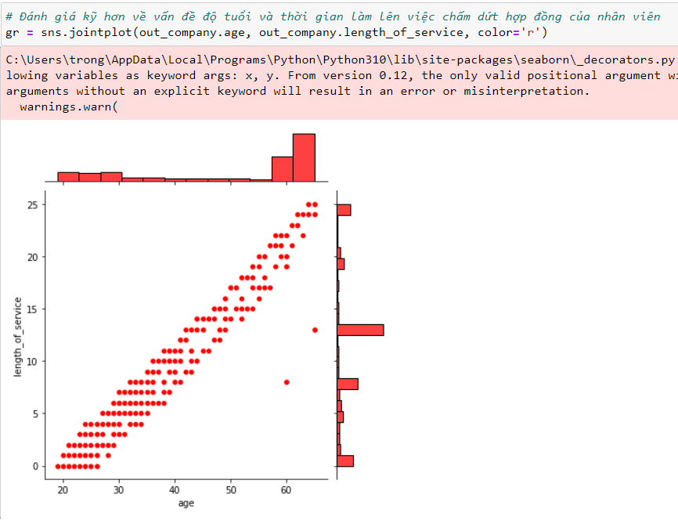
Take a closer look at
the distribution of ages
and service times
for terminations
About 25-27 years old overlaps the service peak of 1-3 years. This is likely people who feel unfit for the job or work environment.
58-61 years old overlaps the service peak of 19-21 years. This is also would be people who are retiring from the work force.
About 19-24 years old overlaps the service peak of 0 years. This is likely people who are trying jobs to find something they would like.
Above 61 years old overlaps the service peak of 25 years. This would be people who are retiring from the work force.
About 28-31 years old overlaps the service peak of 8 years. This is likely people who have become tired of their work and want a career change. It may also be people who have family commitments that force them to change.

Slide 35
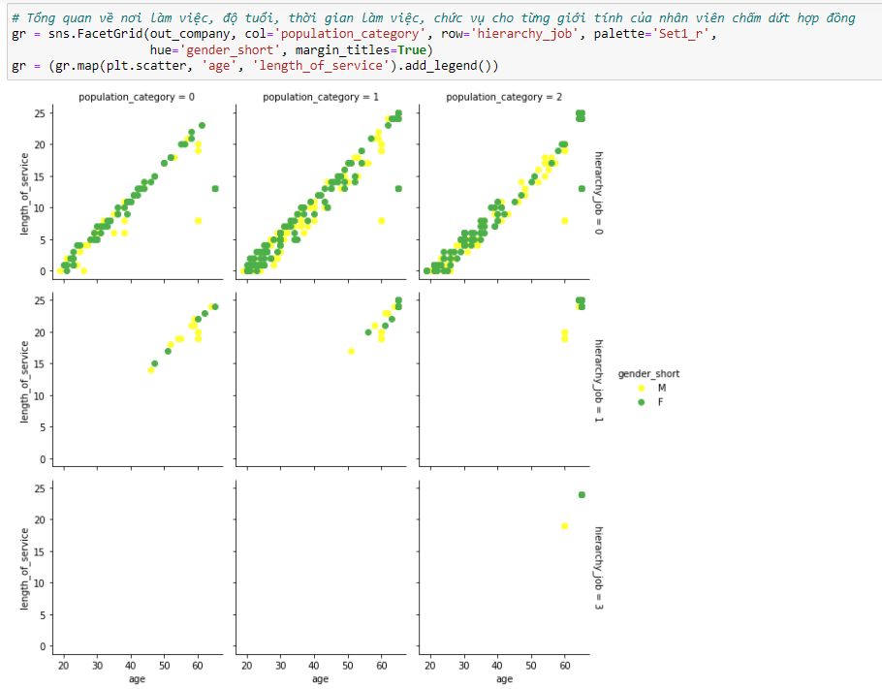
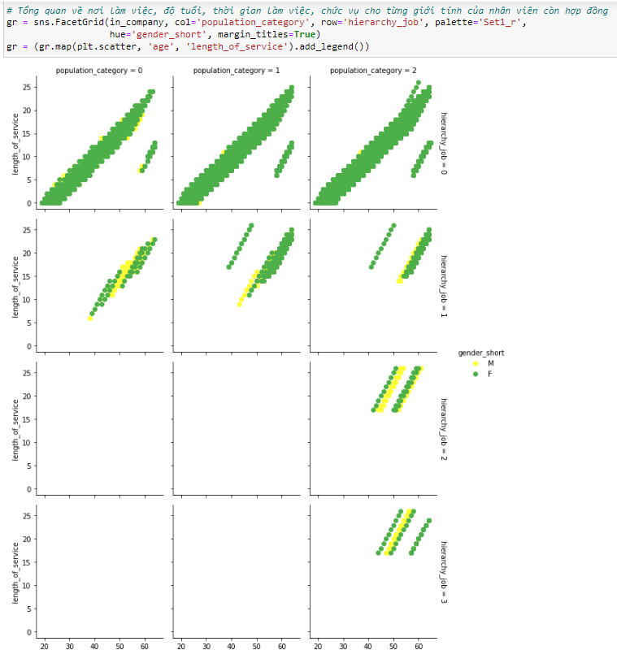
Nobody has stopped employment when they were at executive level
There does not appear to be a major difference in employment termination between males and females
Managers and board members stop employment after at least 14 years of service. This means that they were likely internally promoted to those positions
When someone leaves the company, look at their age, length of service, city size and position in hierarchy. Separated by gender
Do the same for people who are working
in the company
Executives and board members only work in cities

Slide 36
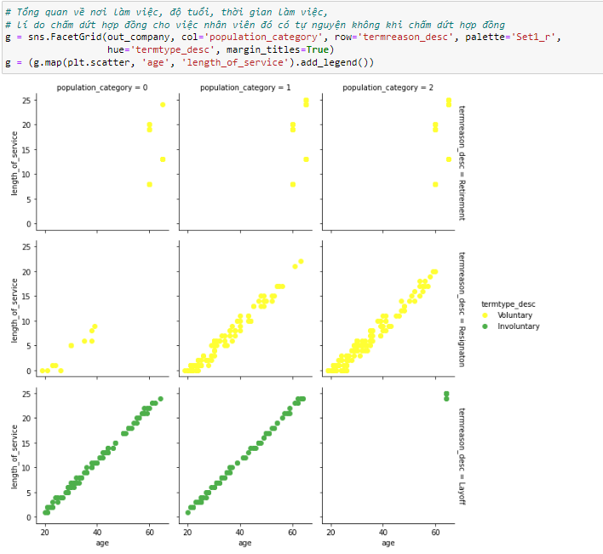
Look at when termination is voluntary or involuntary
Layoffs occur for all ages and all service lengths in remote and rural areas
Resignations are uncommon in remote areas
As expected, layoffs are involuntary, whereas resignations and retirements are voluntary

Slide 37
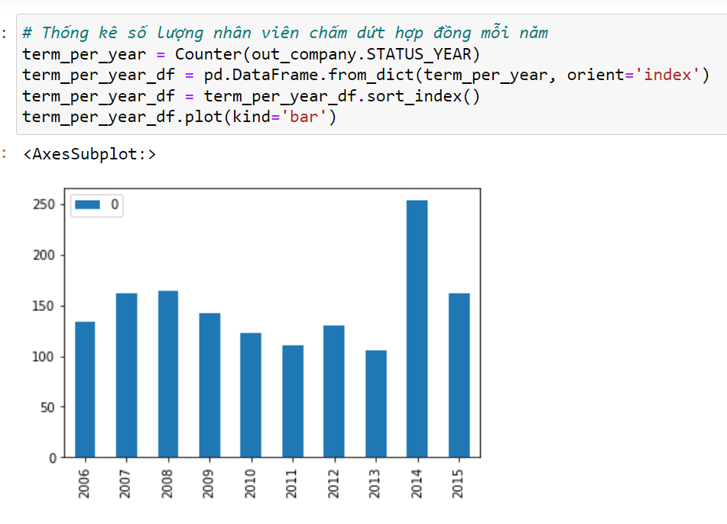
Look at number of terminations per year
2014 had an unusually high number of employment terminations
There was a peak in employment terminations in 2007-2008, when the GFC occurred
Employment terminations in 2015 is similar to the GFC peak, but much lower than the 2014 peak

Slide 38
03
ALGORITHM & EXPERIMENT

Slide 39
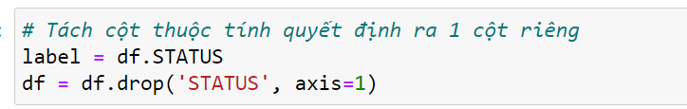
Split the decision attribute column into a separate column

Slide 40
Separate train and test data (train=70%, test=30%)

Slide 41

K-nearest neighbor

Slide 42
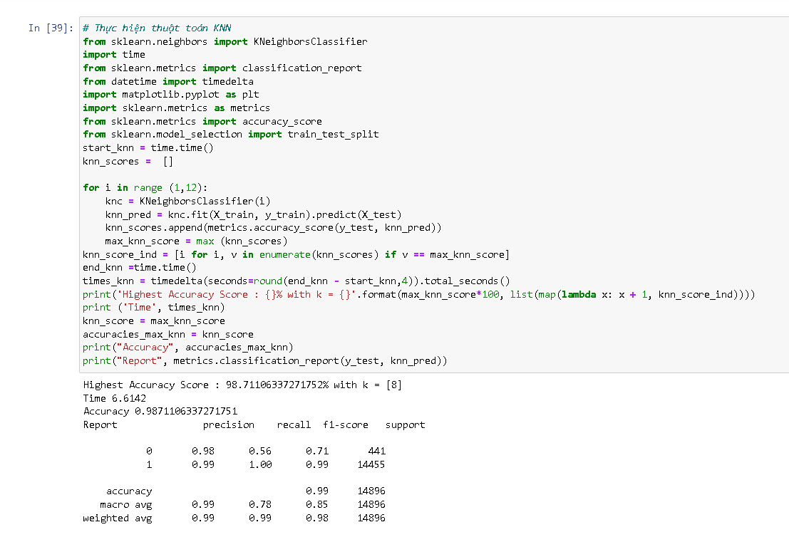

Slide 43
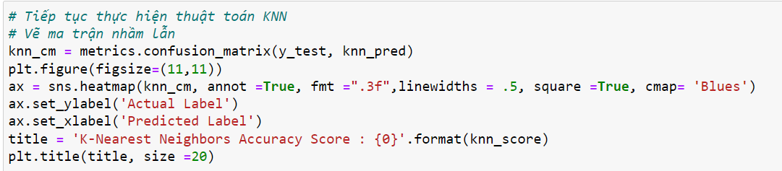
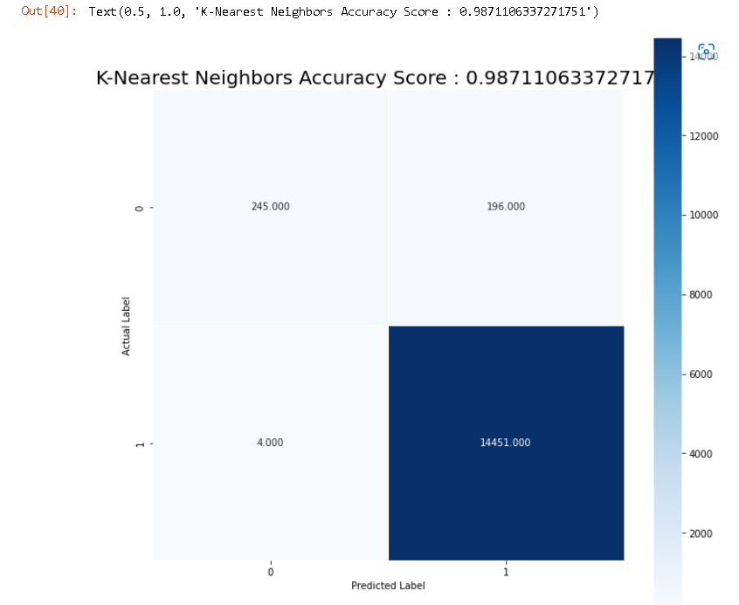
Confusion Matrix

Slide 44

Random Forest

Slide 45
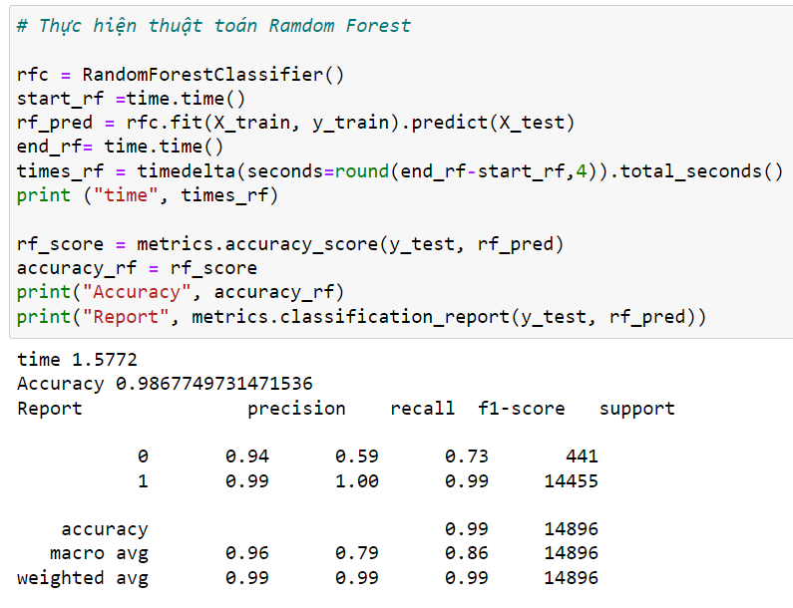

Slide 46
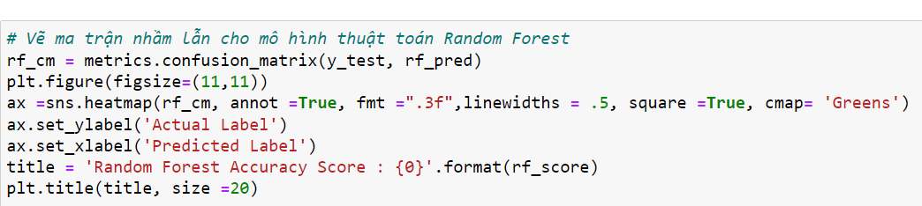
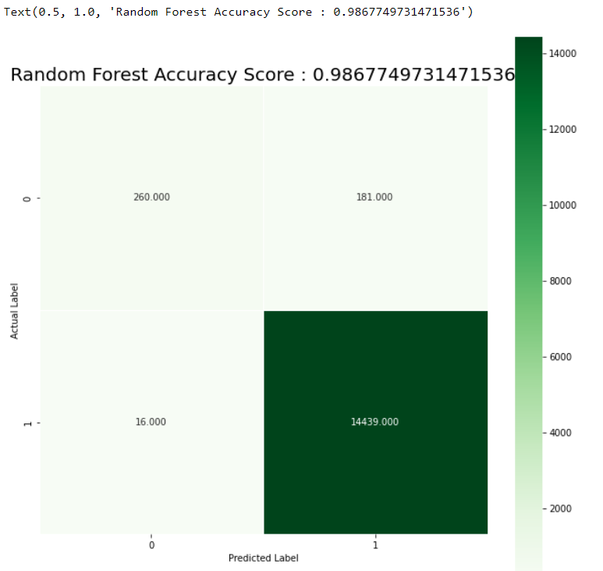
Confusion Matrix

Slide 47
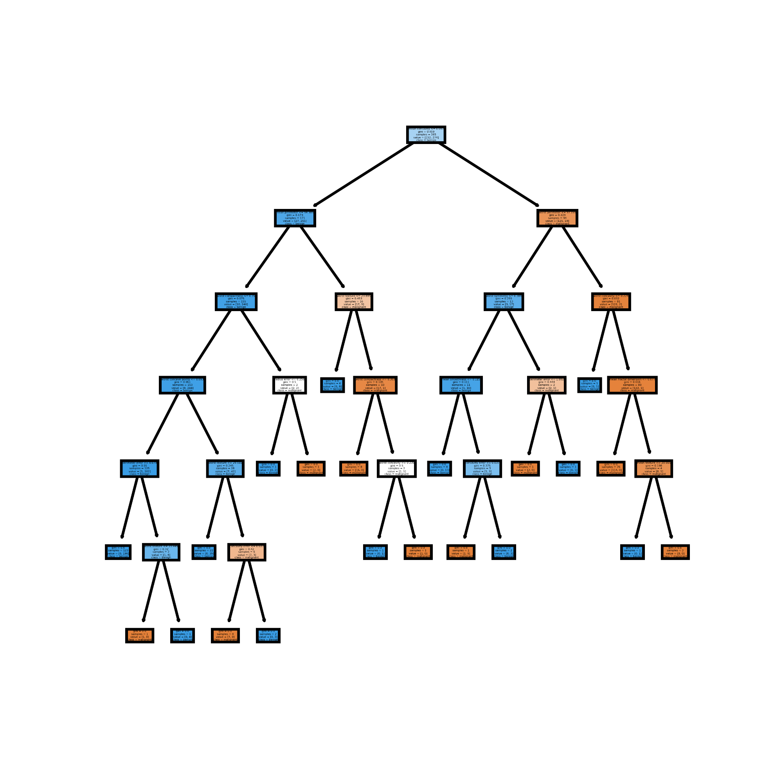
Decision Trees

Slide 48
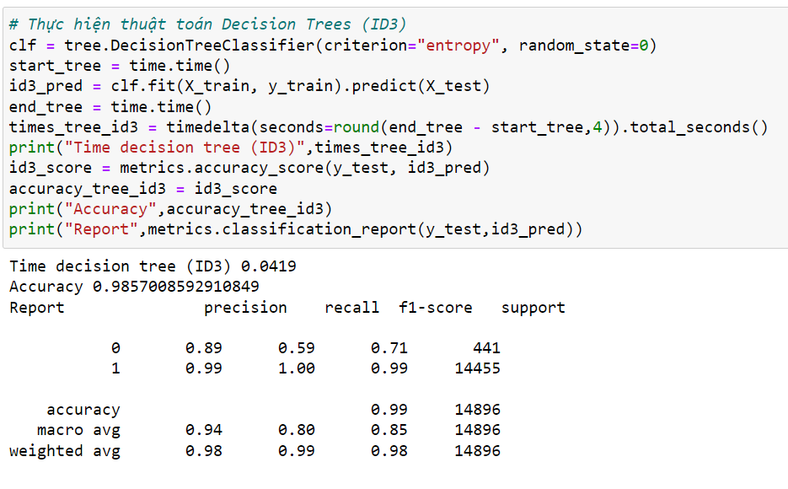
ID3

Slide 49
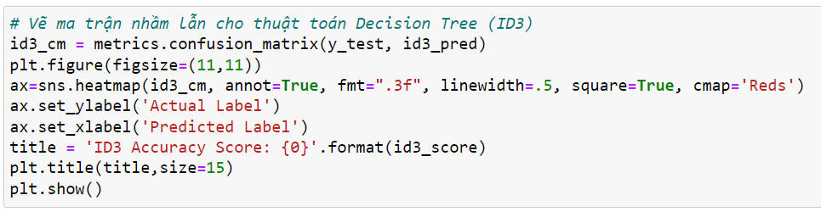
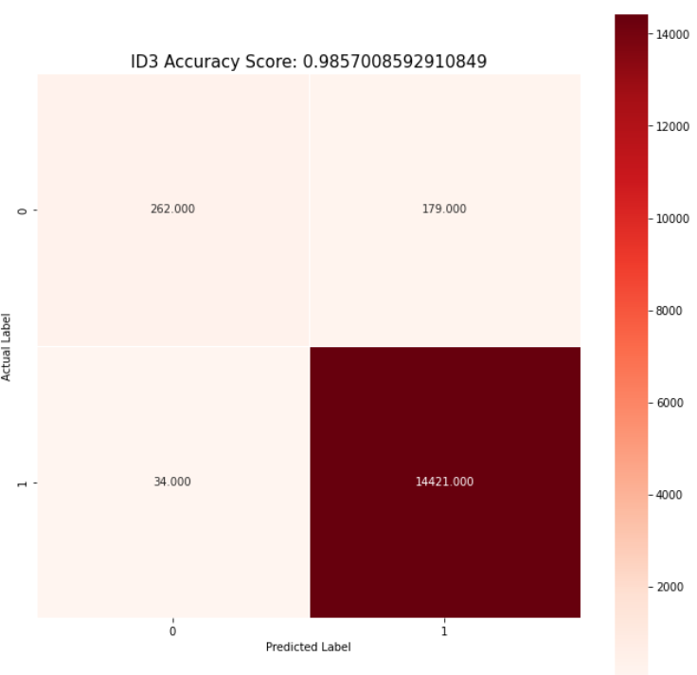
Confusion Matrix

Slide 50
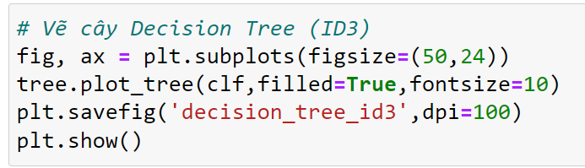
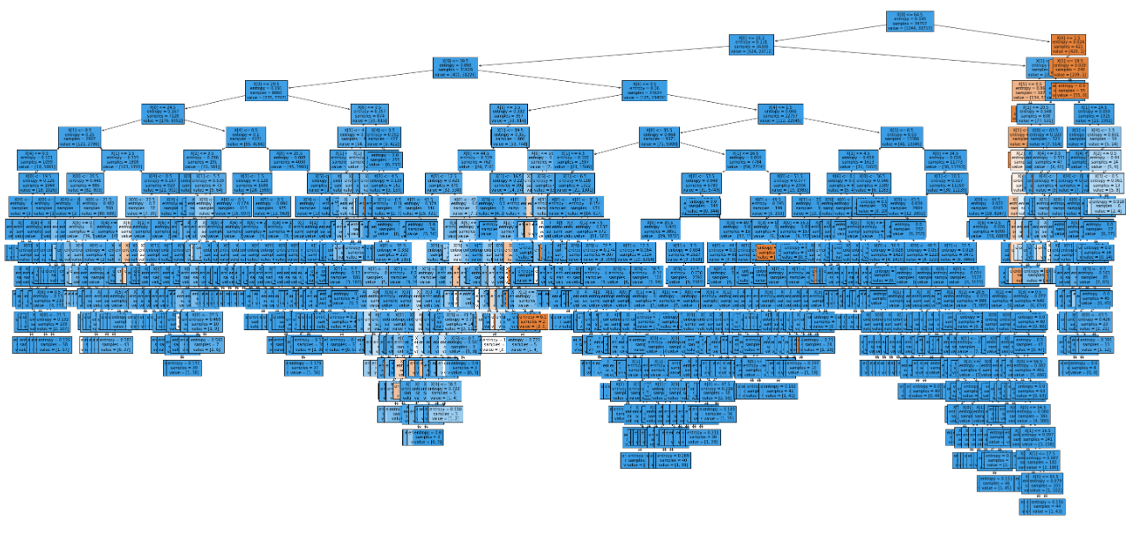
Decision Trees

Slide 51
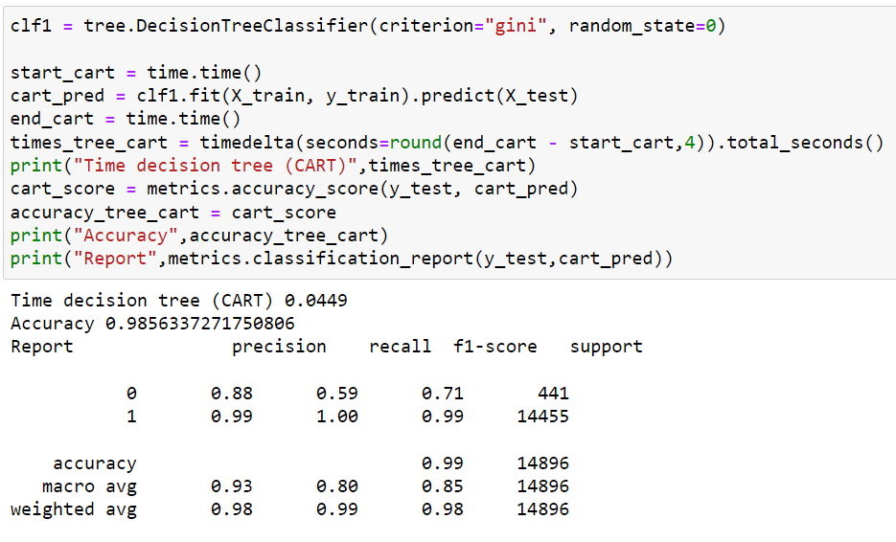
CART

Slide 52
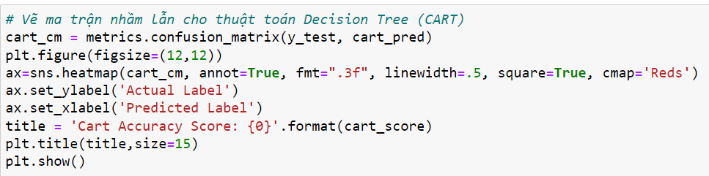

Confusion Matrix

Slide 53

Decision Trees

Slide 54

Naive Bayes

Slide 55


Slide 56


Confusion Matrix

Slide 57

Logistic Regression

Slide 58


Slide 59


Confusion Matrix

Slide 60


Run time comparison

Slide 61

Run time comparison

Slide 62



Accuracies comparison

Slide 63
CONTENTS
01
02
TOPIC OVERVIEW
Deployment
03
04
Conclusion
BUILD AN APPLICATION AND DEMO

Slide 64
BUILD AN APPLICATION AND DEMO
03
Algorithm used
Attributes used to make predictions
Interface
Testing
Code of project

Slide 65

Algorithm used
Based on the results obtained in the previous section, the team decided to use the Random Forest algorithm for this software.
According to the comparison results, although this algorithm has a bad speed, it gives the highest accuracy.

Slide 66

Attributes used to make predictions

Slide 67

Attributes used to make predictions
After calculating the confidence of the attributes, we obtain 5 attributes, namely age, length_of_service, population_category, hierarchy_job and depart_service_Cus to put into the software. These are the 5 attributes with the highest confidence.

Slide 68

Interface

Slide 69
Testing
Data testing:

Slide 70


Testing

Slide 71

Code of project
Source code upload via: https://github.com/TranNhatTan0312/DoAnDataMining.git

Slide 72
CONTENTS
01
02
TOPIC OVERVIEW
Deployment
03
04
Conclusion
BUILD AN APPLICATION AND DEMO

Slide 73
04
Conclusion
Advantage
Disadvantage
Development

Slide 74






SUMMARY
Advantage
Disdvantage
Development direct

Slide 75
TỔNG KẾT
Advantage
1
2
3
Mục đích của môn học
Kỹ năng đạt được
Kinh nghiệm rút ra
Random forest:
Improved with decision tree algorithm, dealing with noise when the data set changes.
Logistic regression:
Good classification when the data is linearly separable.
Easy to deploy and train.

Slide 76
TỔNG KẾT
Advantage
1
2
3
Mục đích của môn học
Kỹ năng đạt được
Kinh nghiệm rút ra
Knearest:
Simple algorithm, easy to implement.
Small computational complexity.
Good handling with noisy data sets.
Decision tree:
Simple, intuitive algorithm, not too complicated to understand at first time.
The training data set is not necessarily too large to build an analytical model.

Slide 77
TỔNG KẾT
Advantage
1
2
3
Mục đích của môn học
Kỹ năng đạt được
Kinh nghiệm rút ra
Naïve bayes:
Independent assumptions
Simple but good enough to solve many problems such as text layering, spam filtering ...
Easy to use and fast
Allows the succession of prior knowledge and obeserved data.

Slide 78


SUMMARY
Advantage
Disdvantage
Development direct

Slide 79
TỔNG KẾT
Disavantage
1
2
3
Mục đích của môn học
Kỹ năng đạt được
Kinh nghiệm rút ra
Random forest:
is a large amount of computation.
Logistic regression:
Easily affected by noise.
Cannot solve non-linear problems.

Slide 80
TỔNG KẾT
Disavantage
1
2
3
Mục đích của môn học
Kỹ năng đạt được
Kinh nghiệm rút ra
Knearest:
With small K, it is easy to encounter noise, leading to inaccurate results
It takes a long time to perform because it has to calculate the distance to all the objects in the data set.
Need to convert data types to qualitative factors.
Decision tree:
Decision tree algorithm only applies to qualitative variables (classification tree) if wrong classification can lead to serious error.
Decision tree algorithms are likely to be “biased” or biased if the dataset is unbalanced..

Slide 81
TỔNG KẾT
Disavantage
1
2
3
Mục đích của môn học
Kỹ năng đạt được
Kinh nghiệm rút ra
Naïve Bayes:
The accuracy of Naive Bayes compared to other algorithms is not high.
In the real world, it is almost impossible when the features of test data are independent of each other.
Problem zero (stated how to solve it above).
The model is not trained by a strong and rigorous optimization method.
The parameters of the model are estimates of the probability of single conditions.

Slide 82
SUMMARY
Advantage
Disdvantage
Development direct

Slide 83
TỔNG KẾT
Development derection
1
2
3
Mục đích của môn học
Kỹ năng đạt được
Kinh nghiệm rút ra
Research and learn more about datasets, adjust attributes and preprocessors for better accuracy.
Continue to apply other classification algorithms such as SVM, Artificial Neuron Network, ... to find the optimal algorithm.

Slide 84
SUMMARY
Advantage
Disdvantage
Development direct

Slide 85


Thanks!
DO YOU HAVE ANY QUESTIONS?

